Slide 1
Welcome Gray Articles Carrefour Fortress

Slide 2
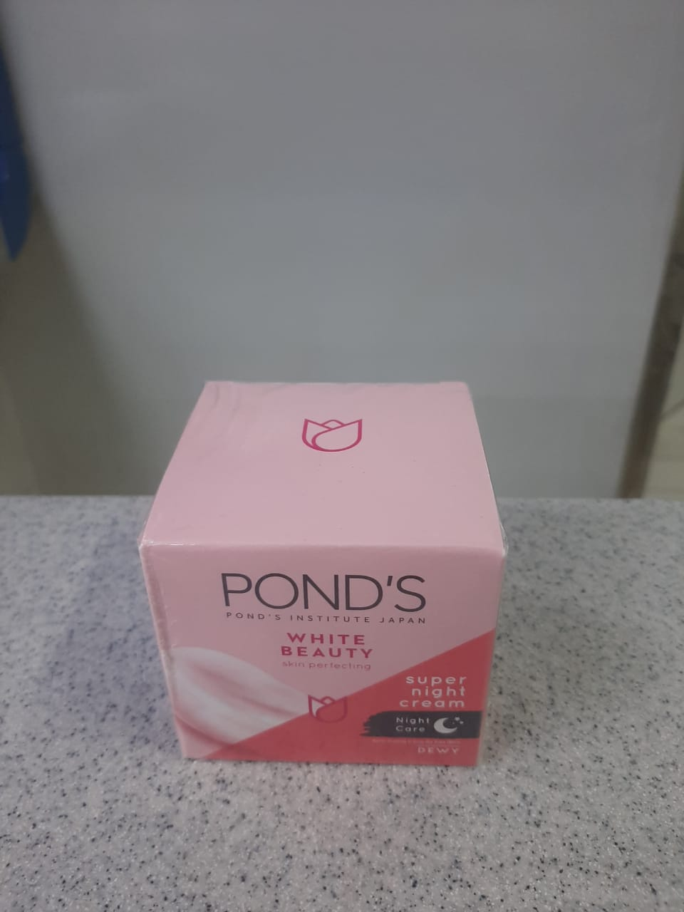
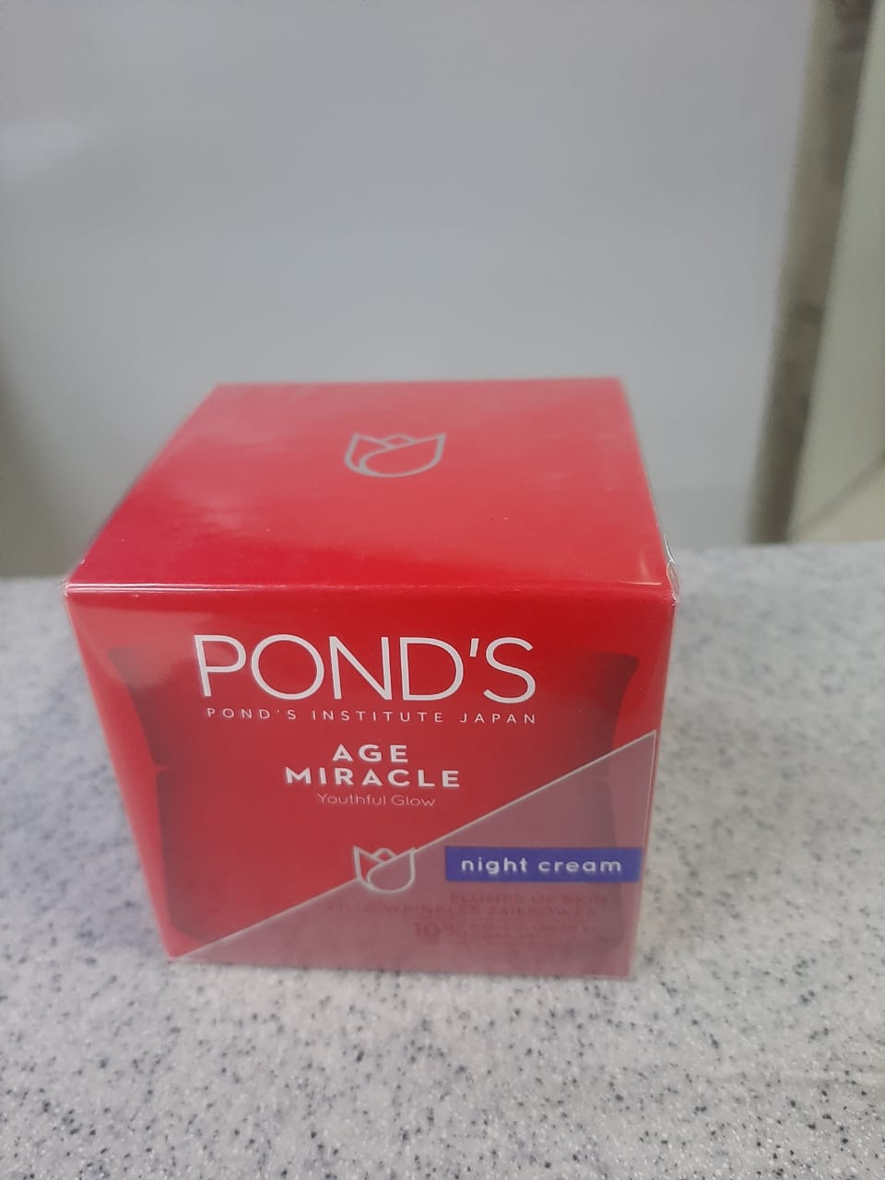
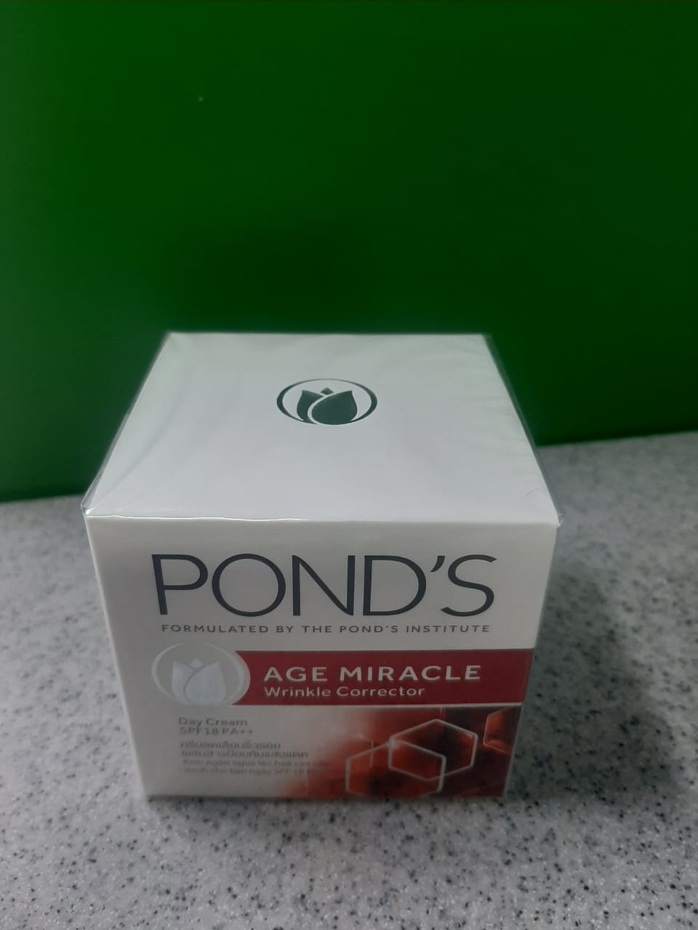
Channal Carrefour
Ponds White Beauty Night
Cream 50gm
Ponds Age Miricle Night
Cream 50gm
Ponds White Beauty Face
Wash 50GM

Slide 3
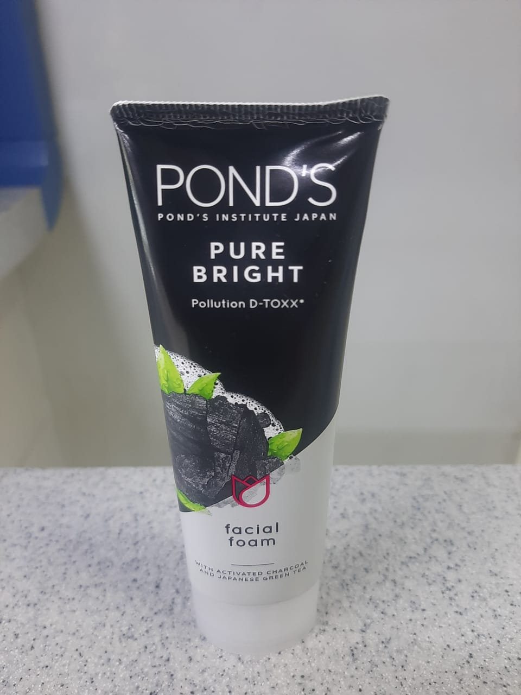
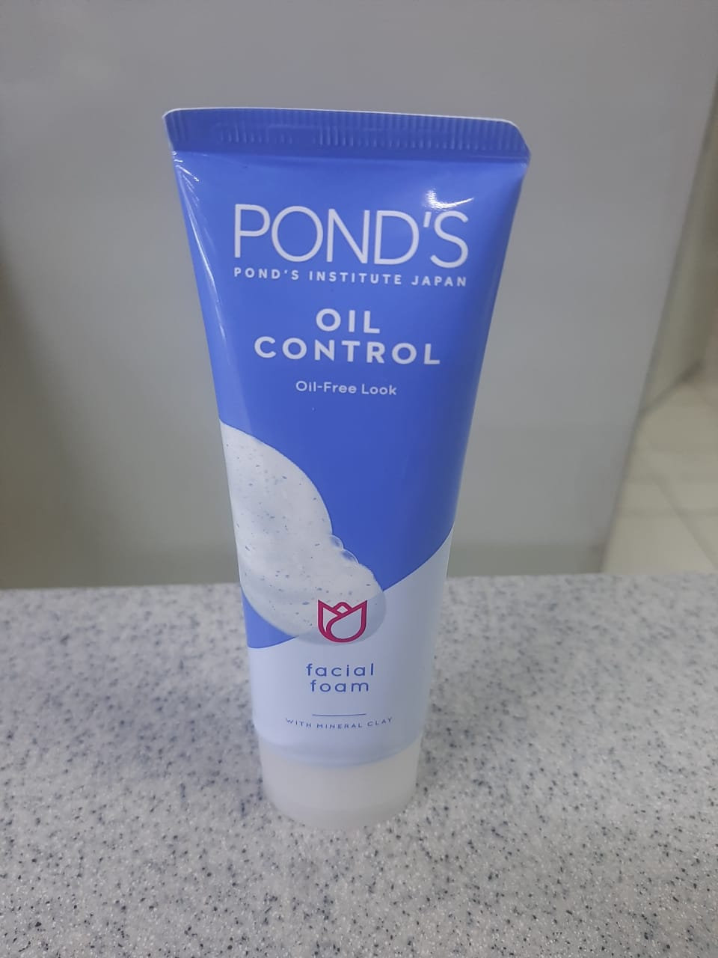
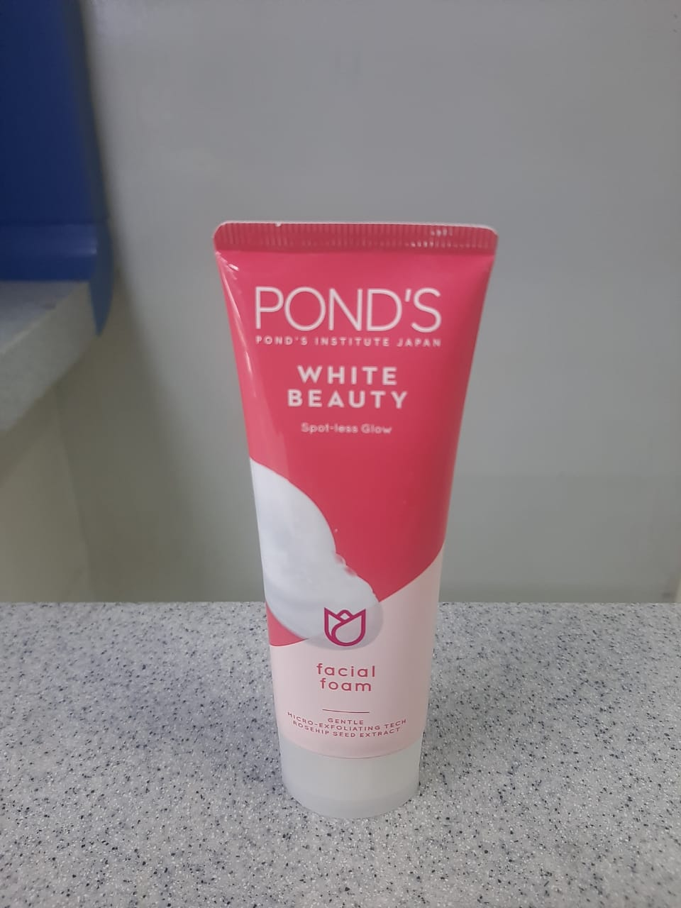
Channal Carrefour
Ponds Pure Bright Face wash
50gm
Ponds Oil Control Facewash
50gm
Ponds White Bright Face
Wash 50gm

Slide 4
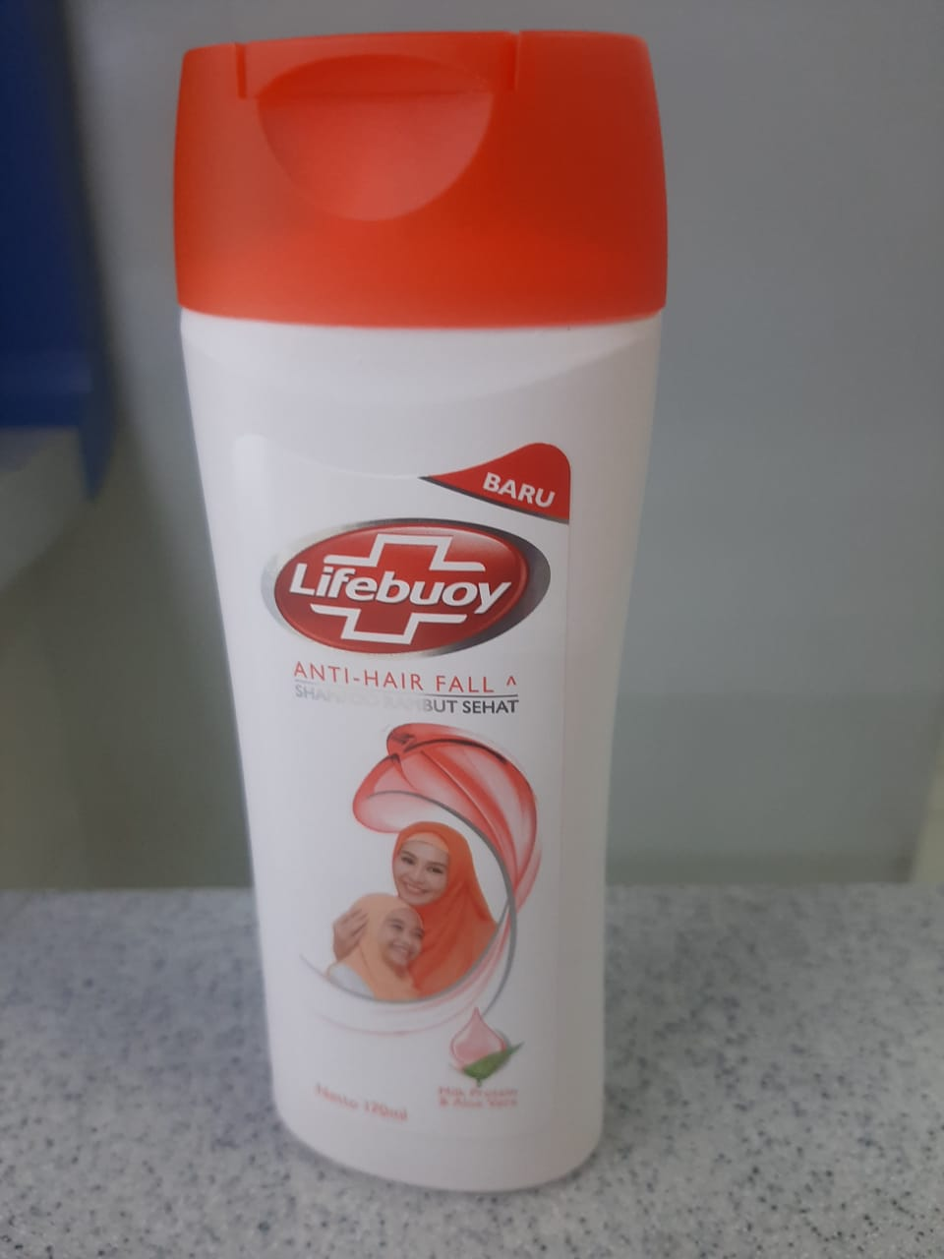
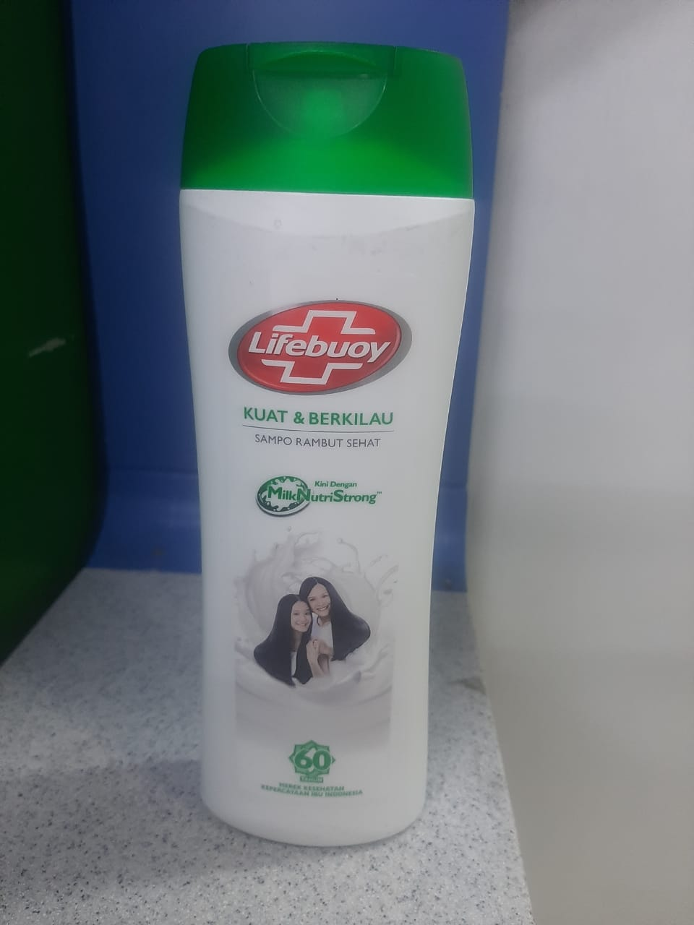
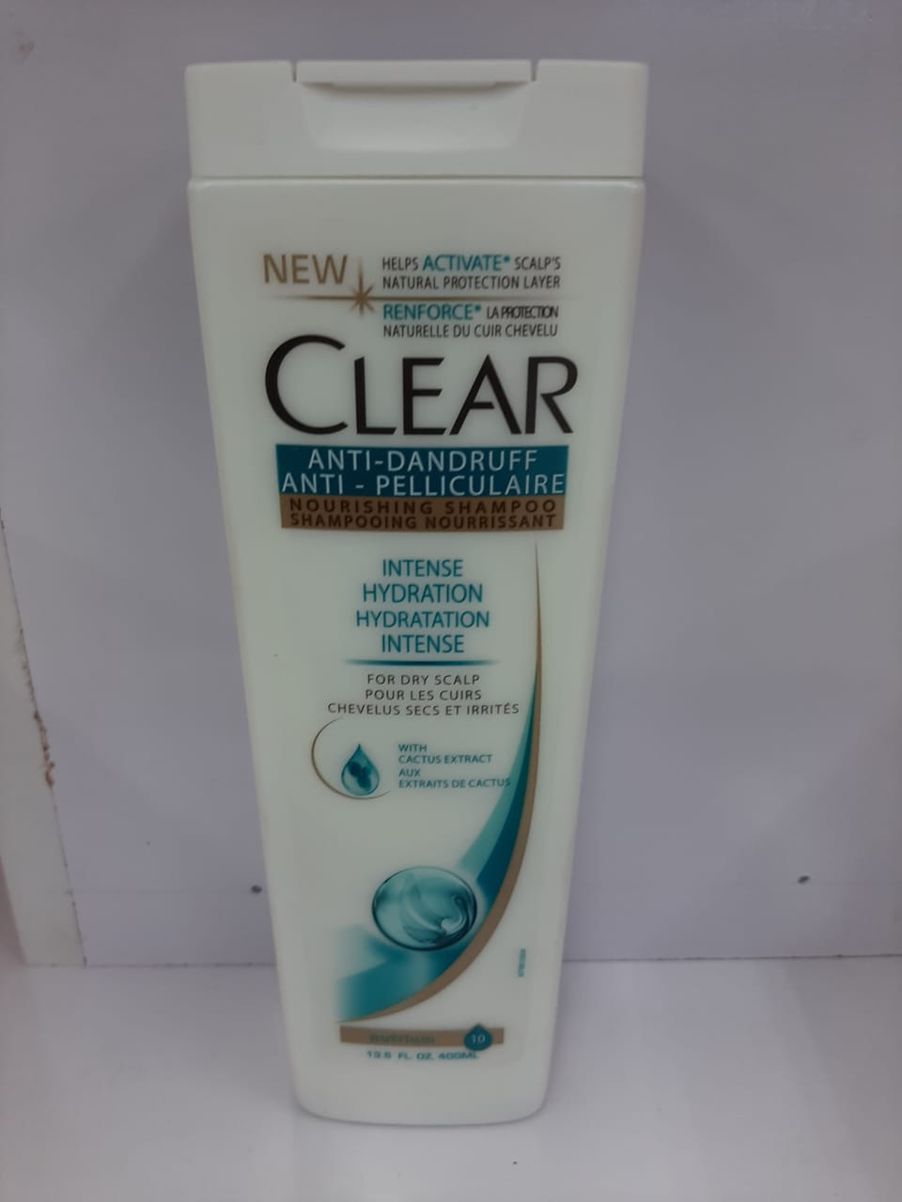
Channal Carrefour
Lifebuoy Shampoo Netto
340ml
Lifebuoyy Shampoo 340ml
Clear Shampoo 250ml

Slide 5
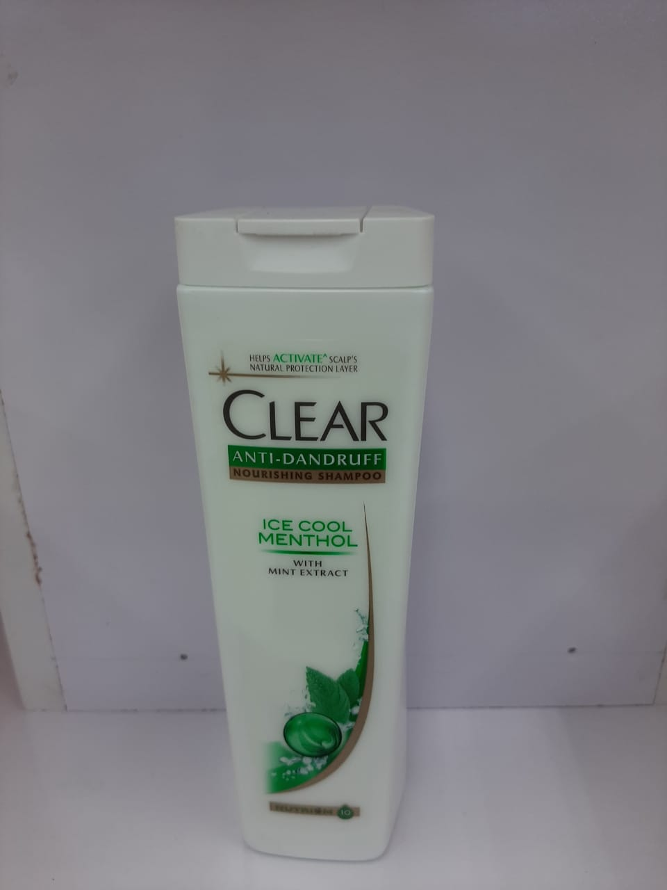
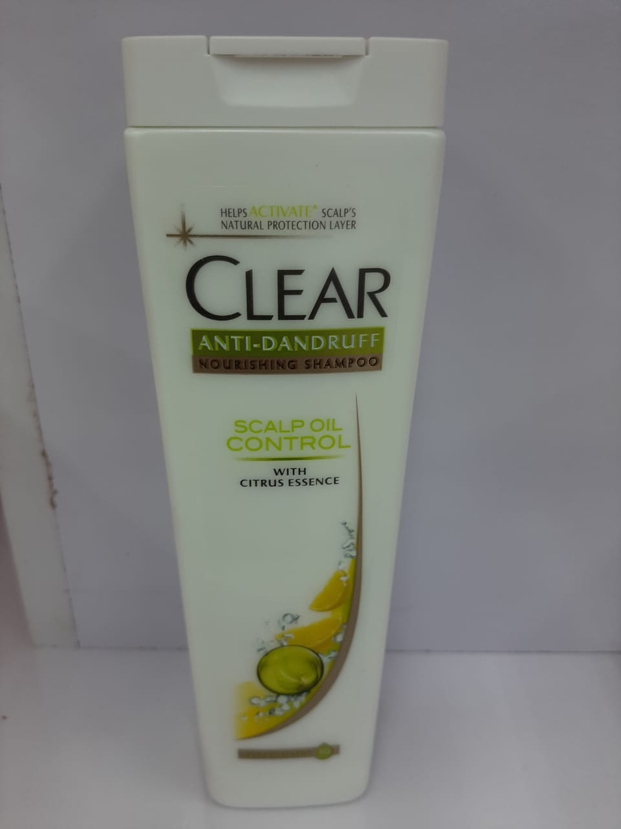
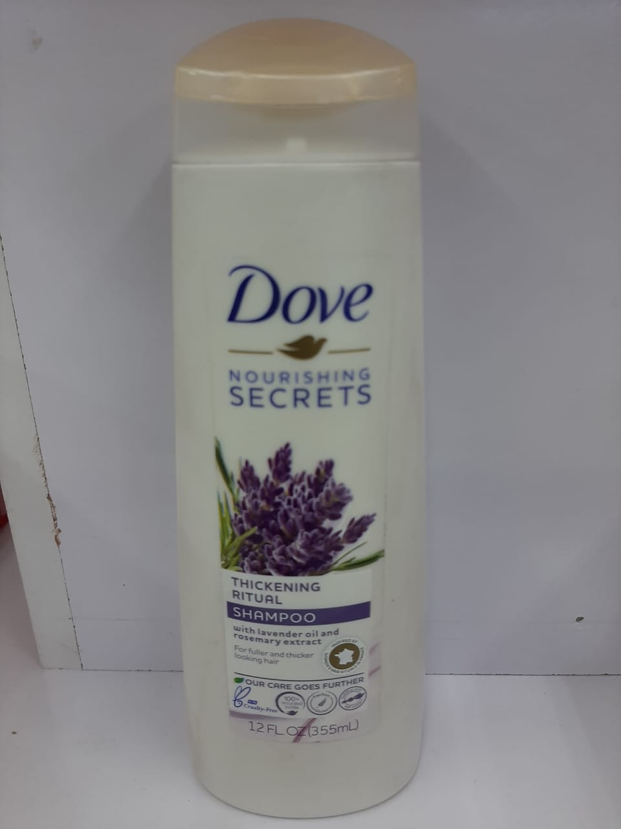
Channal Carrefour
Clear Shampoo Icecool
Menthol 250ml
Clear Shampoo Scalp Control 250ml
Dove Shampoo Thickening
355ml

Slide 6
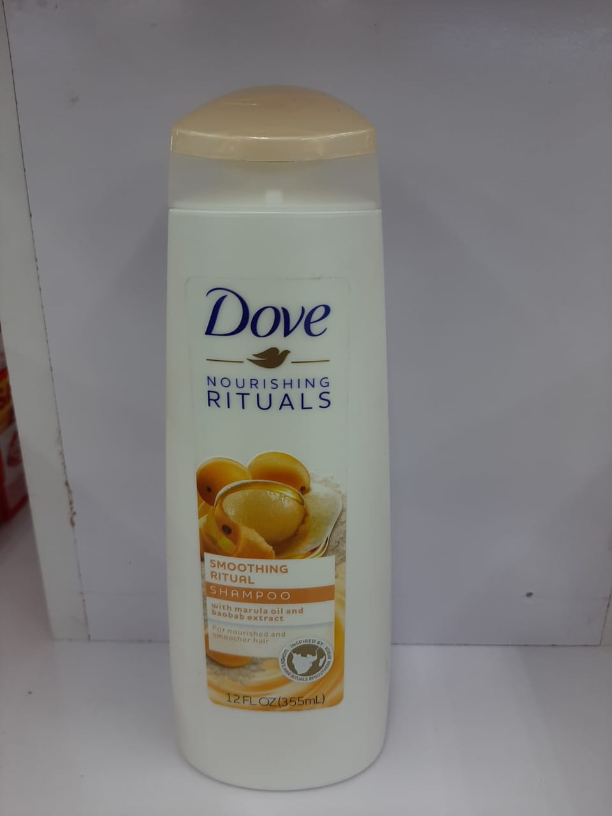
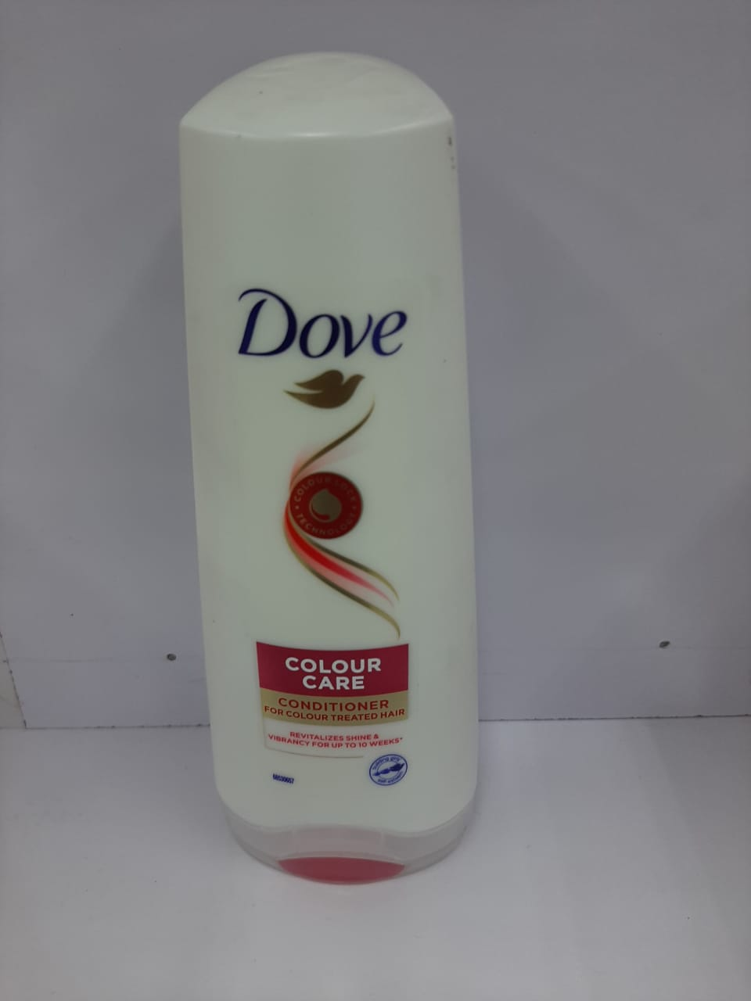
Channal Carrefour
Dove Shampoo Smoothing
Ritual 355ml
Dove Conditioner Colour Care 200ml
Dove Shampoo Thickening
355ml

Slide 7
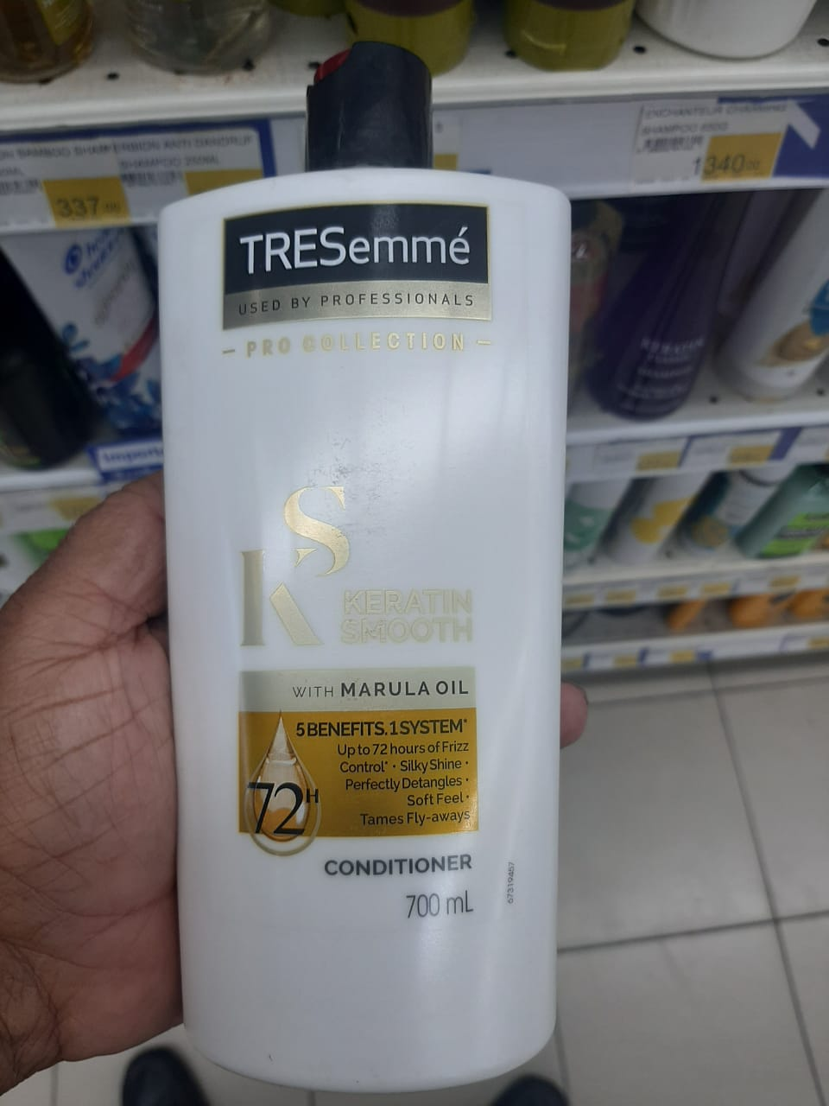
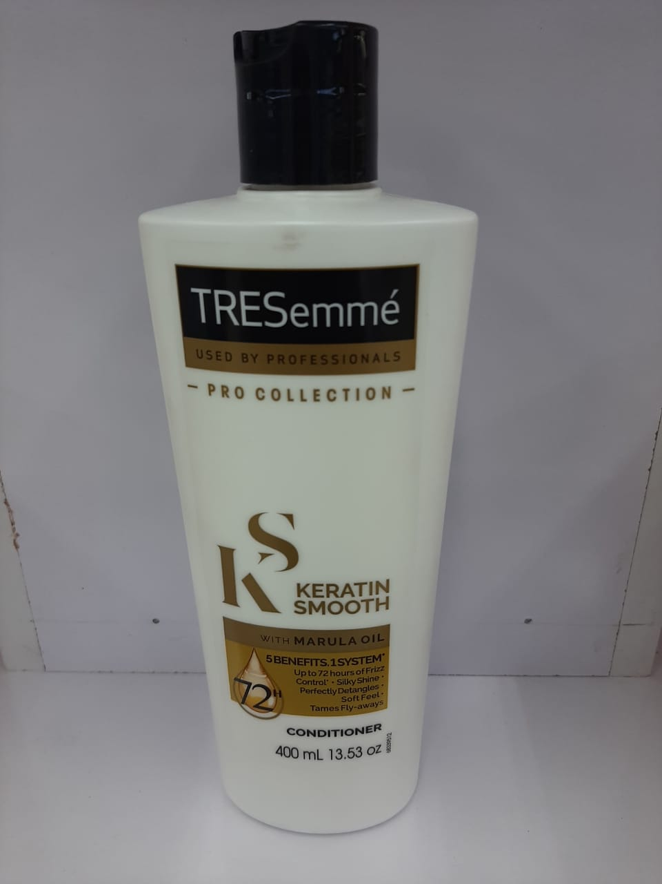
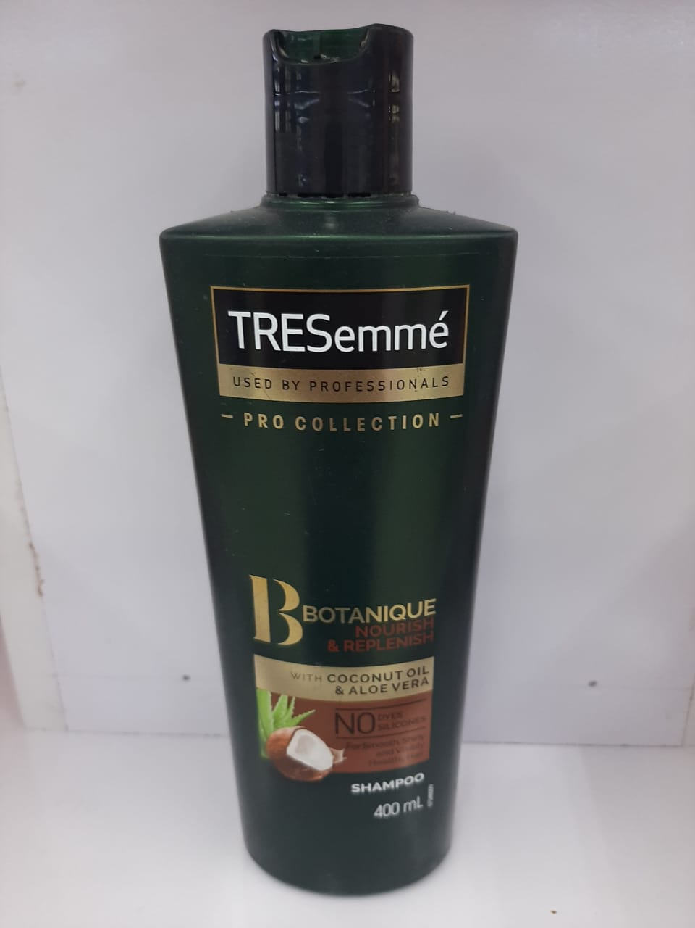
Channal Carrefour
Tresemme Conditioner Keratin
Smooth 700ml
Tresemme Conditioner Keratin
Smooth 400ml
Tresemme Shampoo Nourish & Replenish 400ml

Slide 8
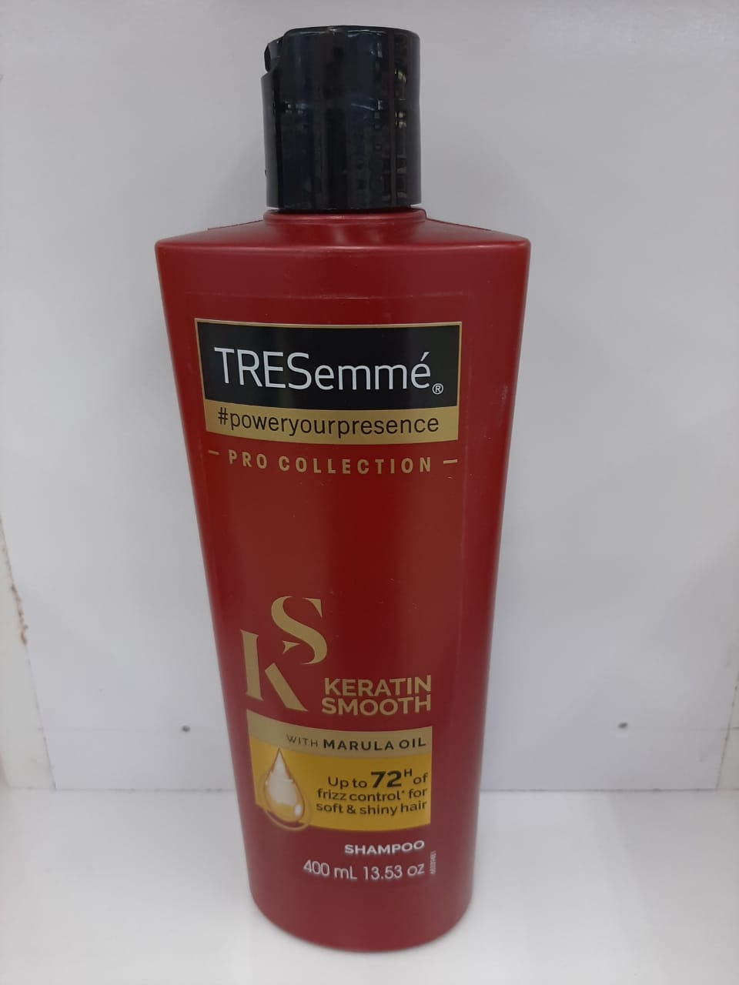
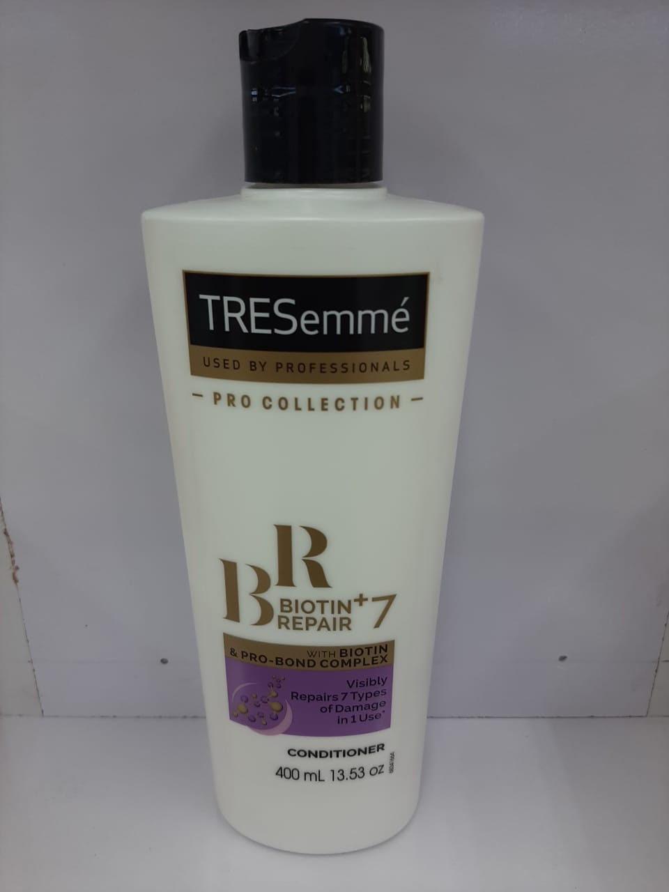
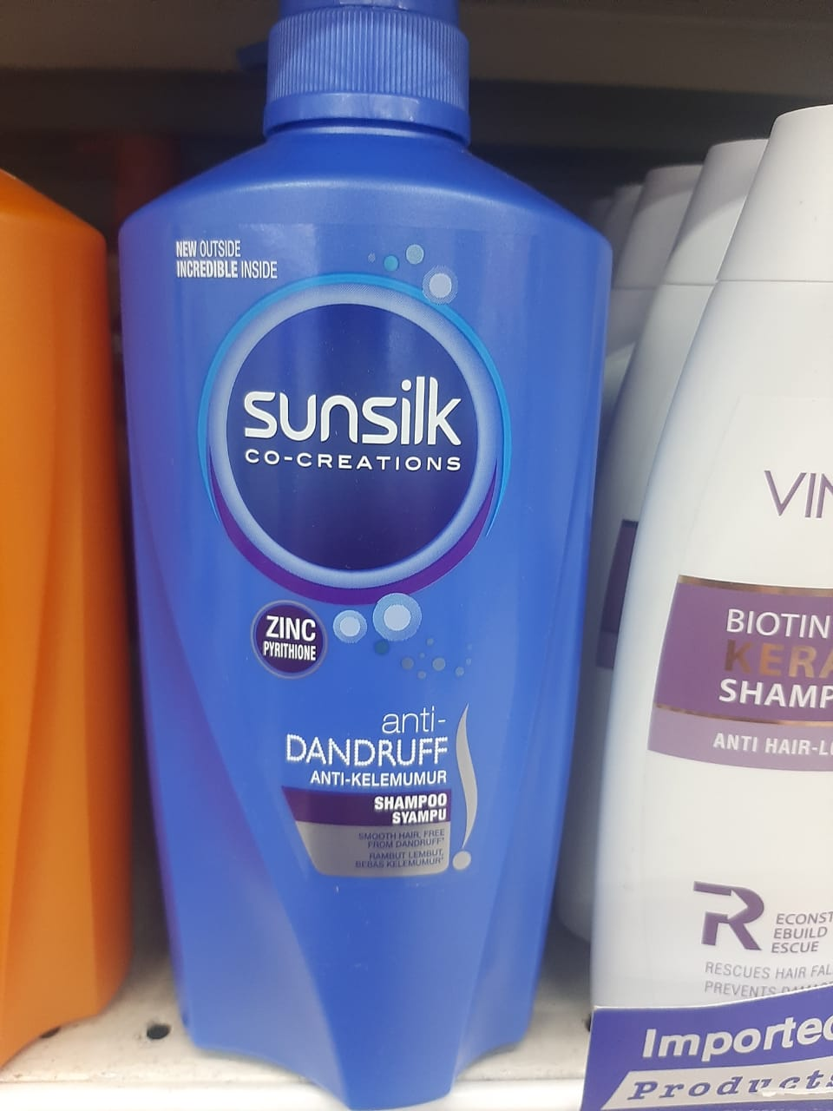
Channal Carrefour
Tresemme Shampoo Keratin
Smooth 400ml
Tresemme Conditioner Biotin 400ml
Sunsilk Shampoo Ad 650ml

Slide 9
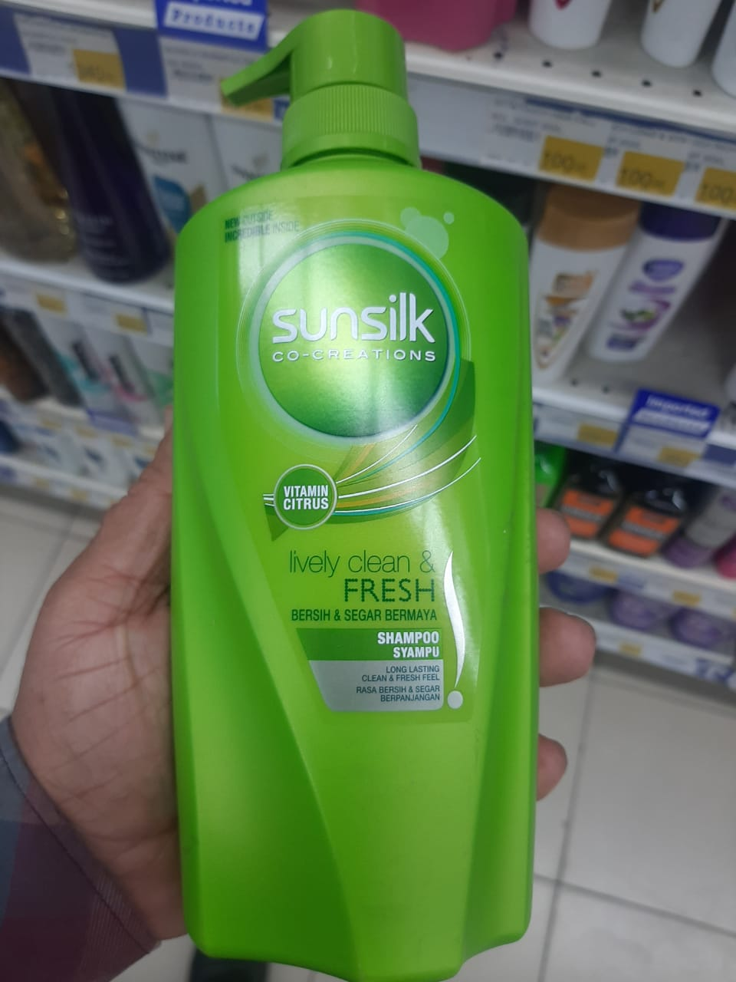
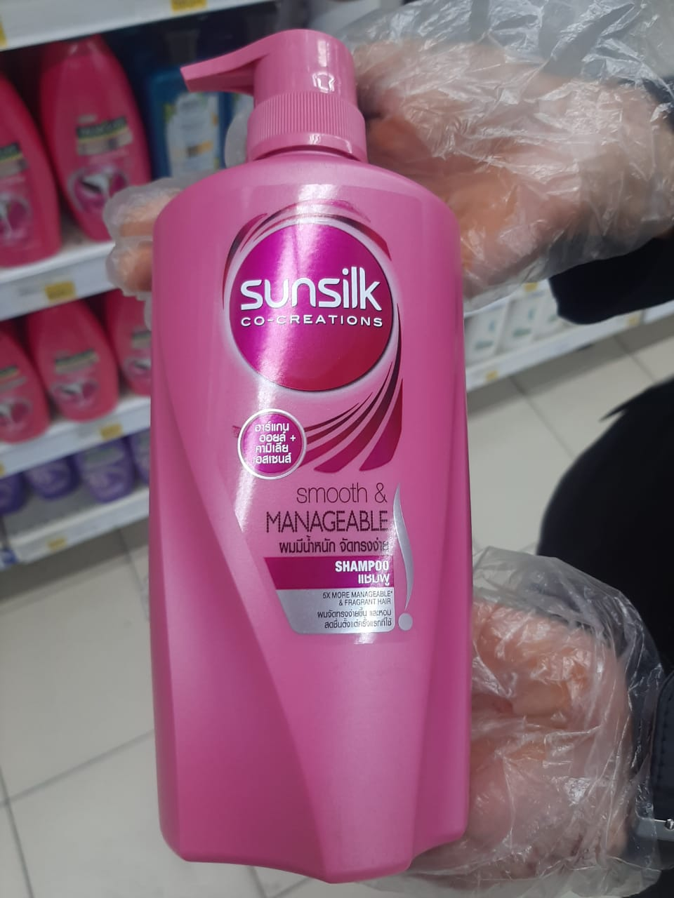
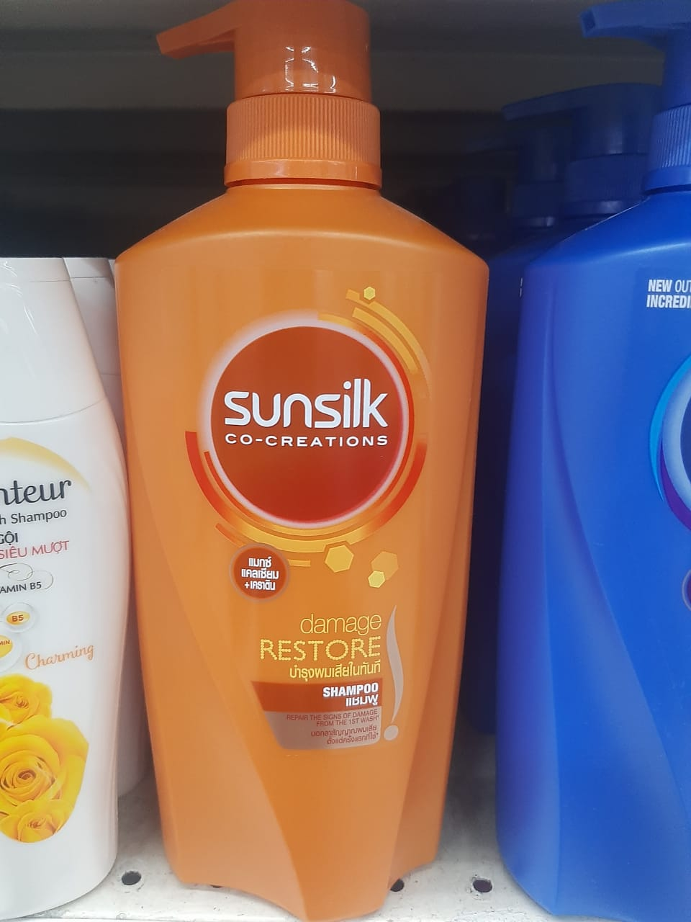
Channal Carrefour
Sunsilk Shampoo Clean &
Fresh 650ml
Sunsilk Shampoo Smooth &
Mangeable 650ml
Sunsilk Shampoo damage
restore 650ml

Slide 10
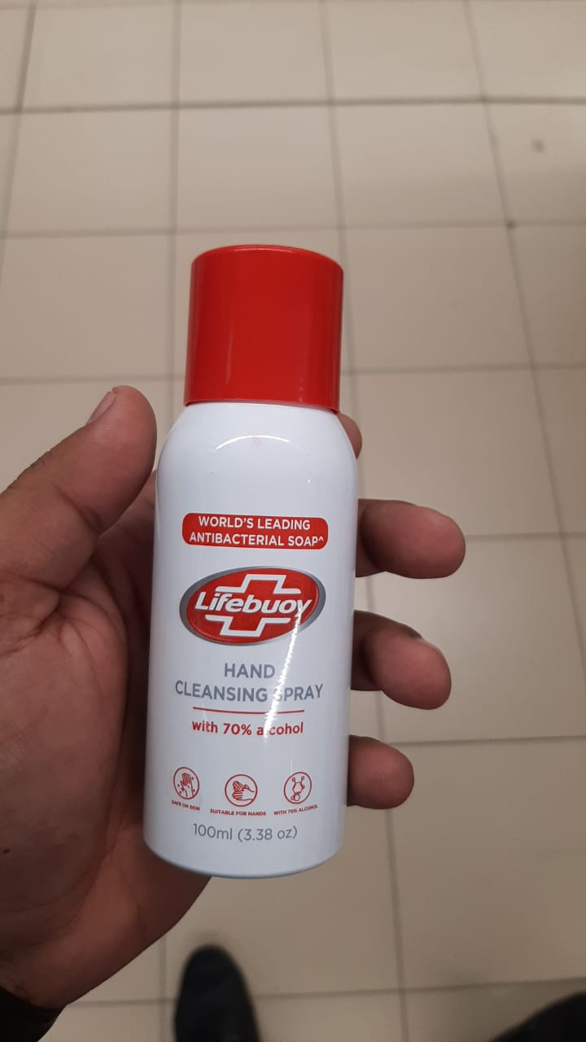
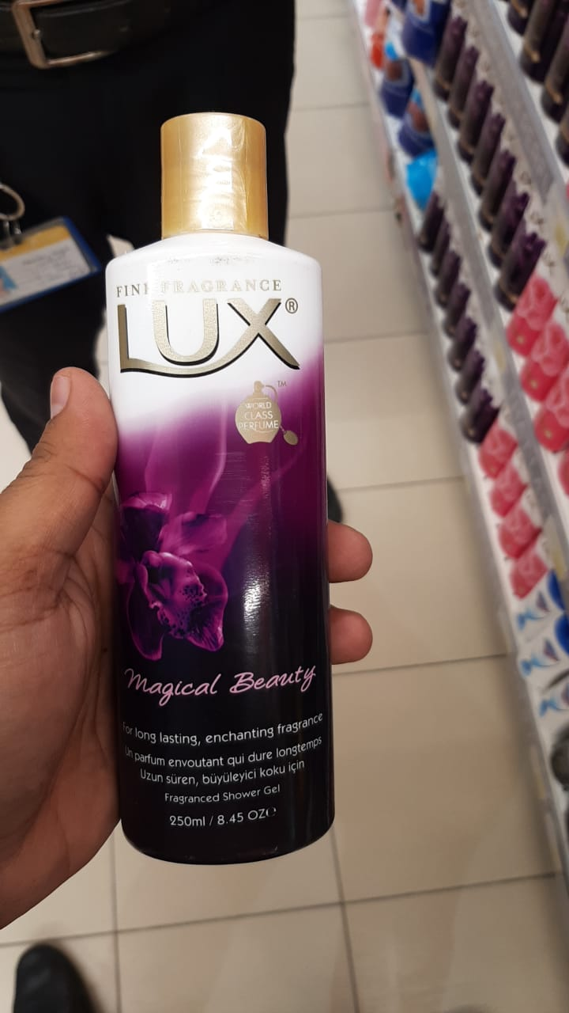
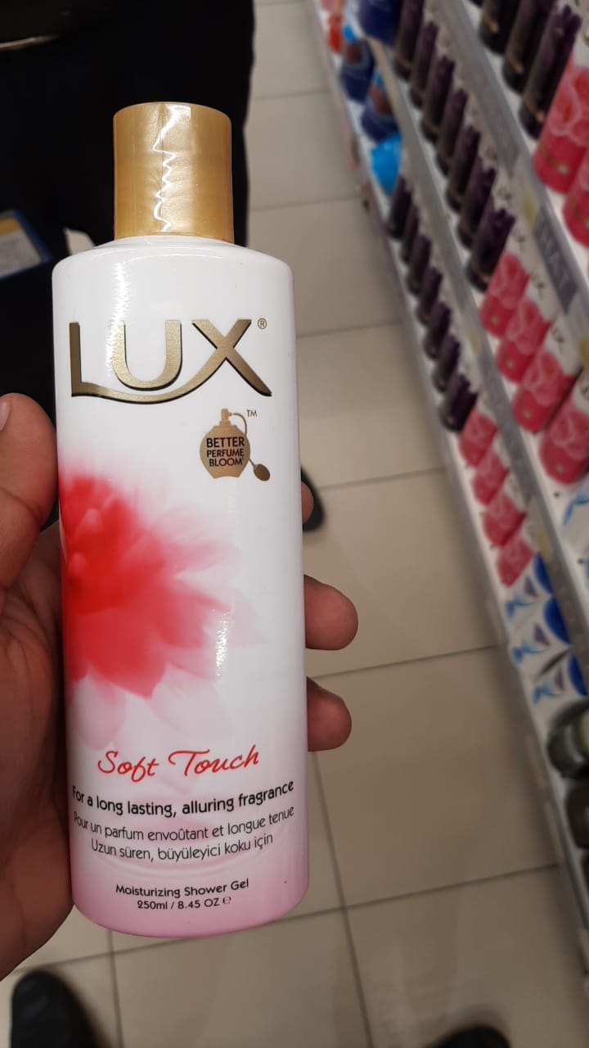
Channal Carrefour
Lifebuoy Hand cleaning Spray 100ml
Lux Bodywash Magical Beauty 250ml
Lux Bodywash Soft Touch
250ml

Slide 11
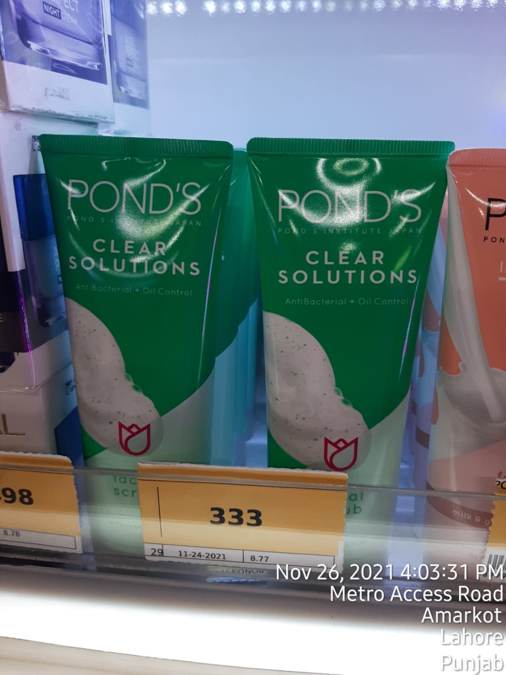
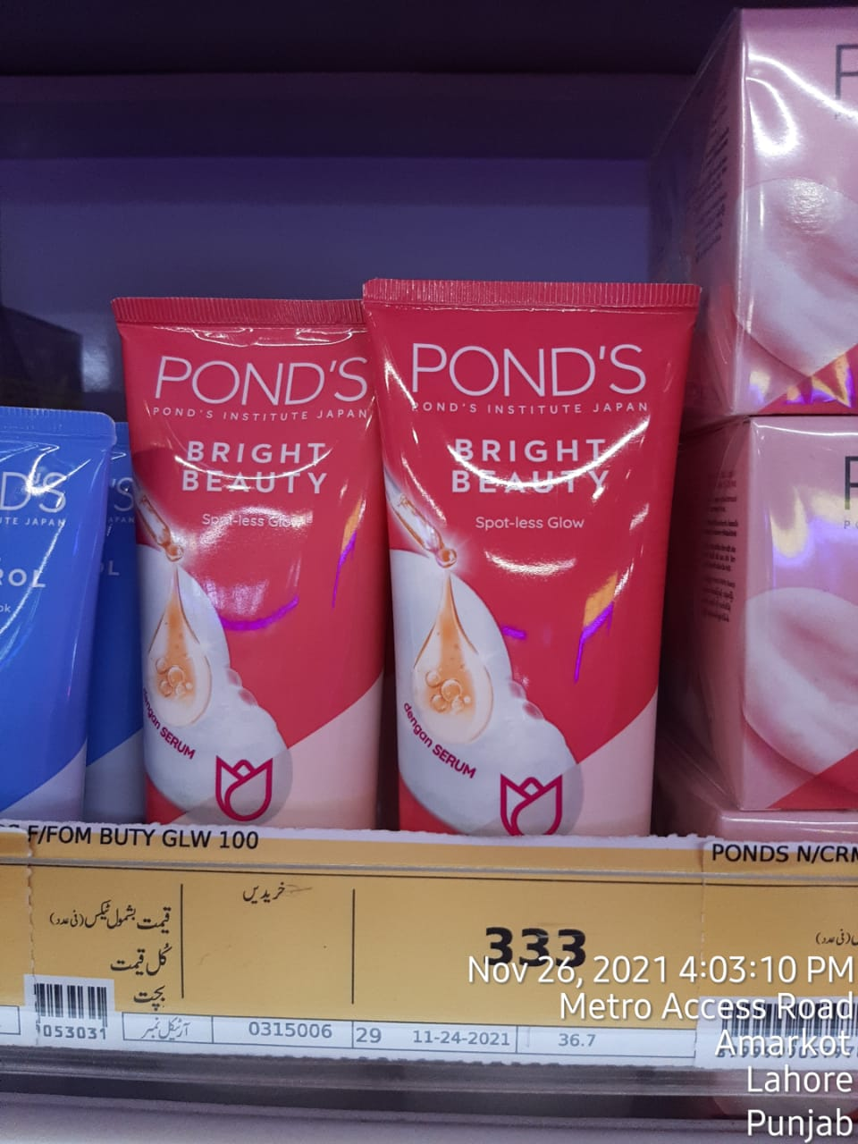
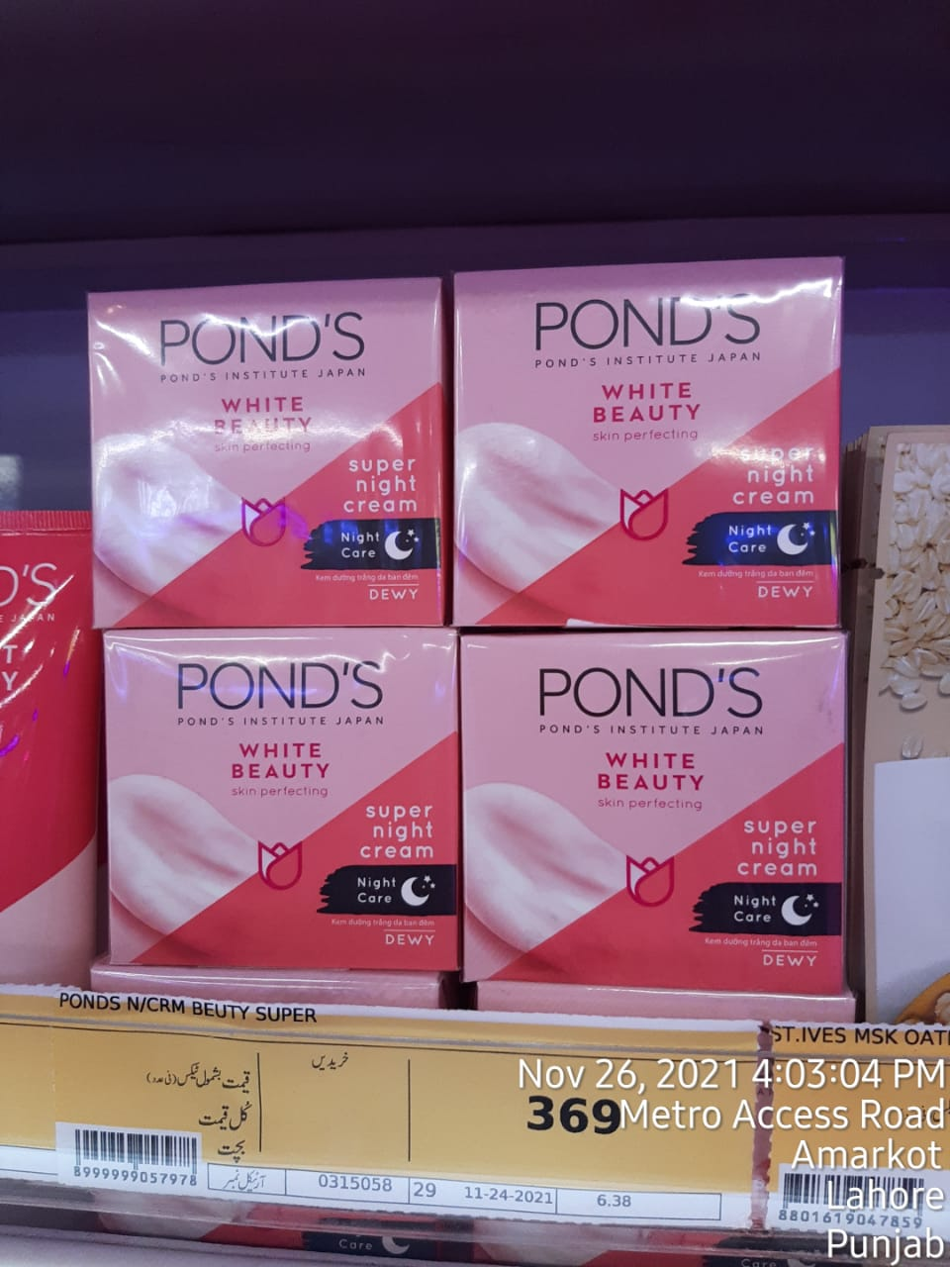
Channal Metro
Ponds Clear Solutions
Facewash 100gm
Ponds Bright Beauty
Facewash 100gm
Ponds White Beauty Night
Cream 50gm

Slide 12
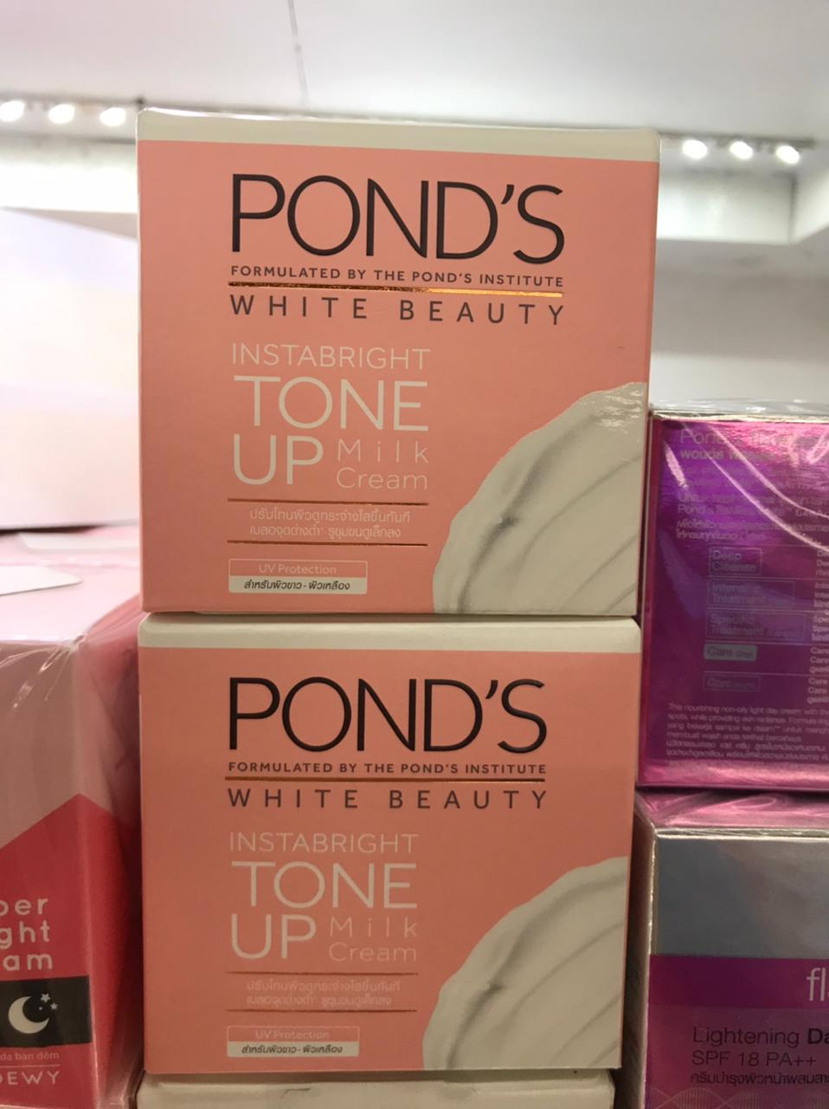
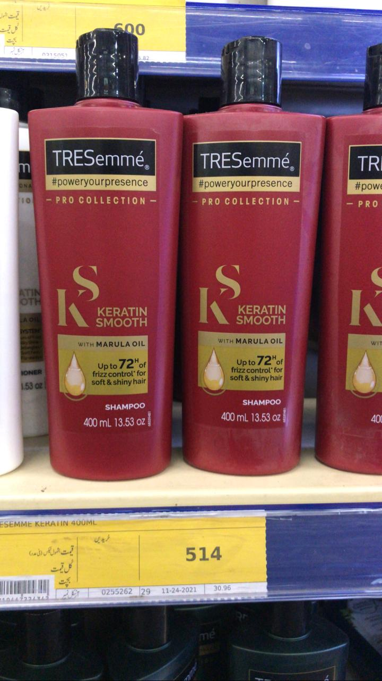
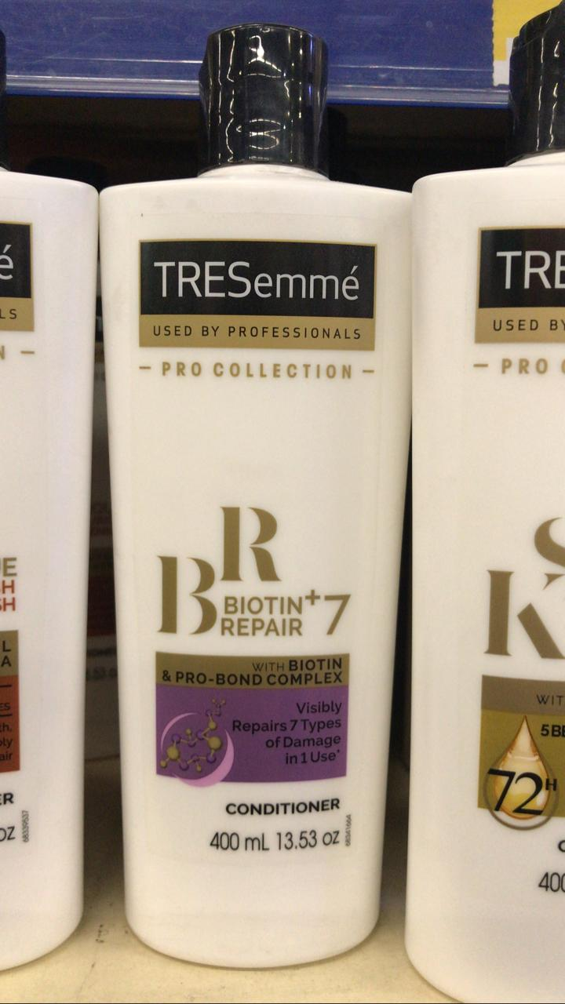
Channal Metro
Ponds Toneup Cream 50gm
Tresemme Shampoo Keratin
Smooth 400ml
Tresemme Conditioner Biotin 700ml

Slide 13
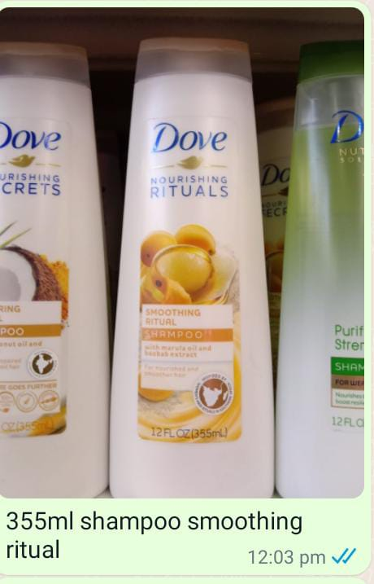
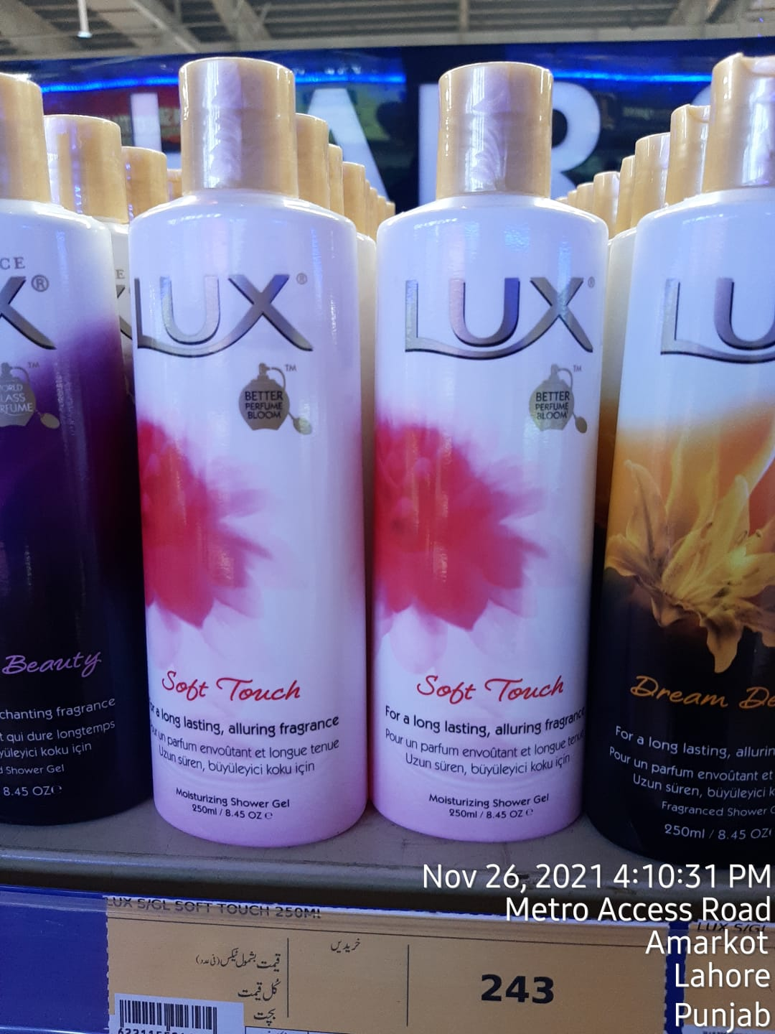
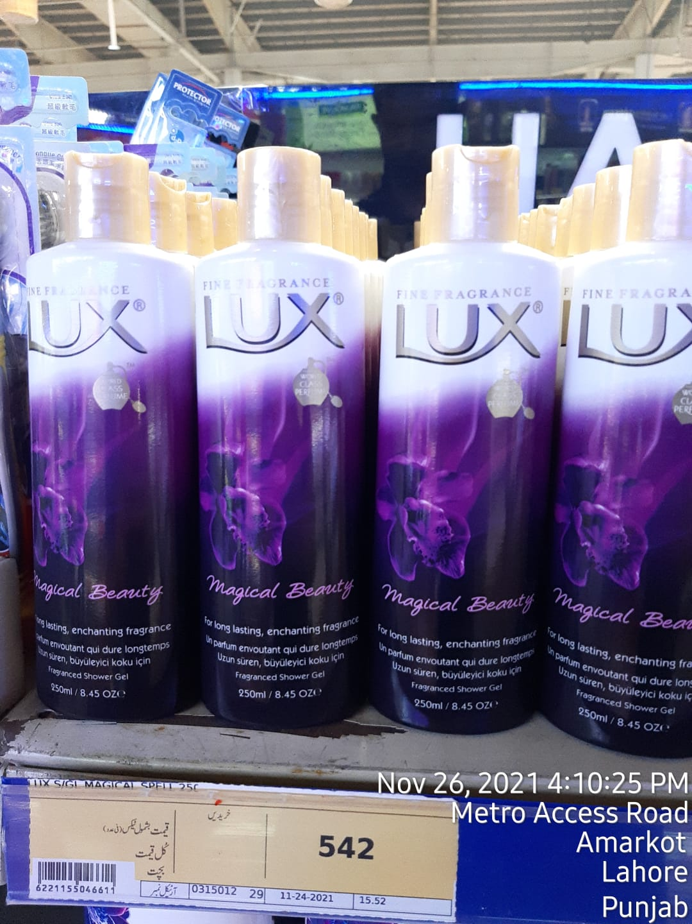
Channal Metro
Lux Bodywash Soft Touch
250ml
Lux Bodywash Magical
Beauty 250ml
Dove Shampoo Smoothing
Ritual 355ml

Slide 14
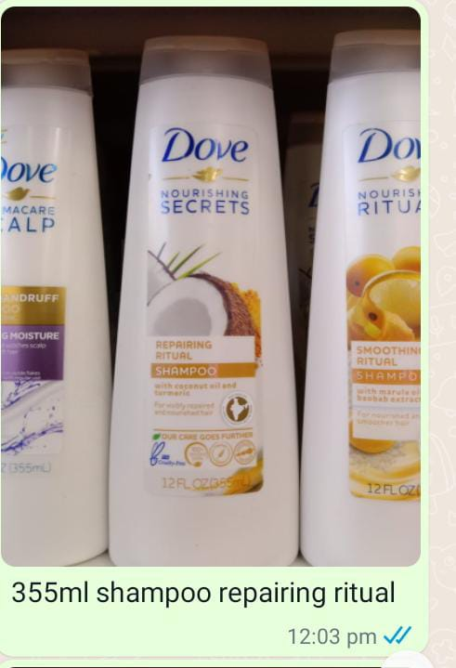
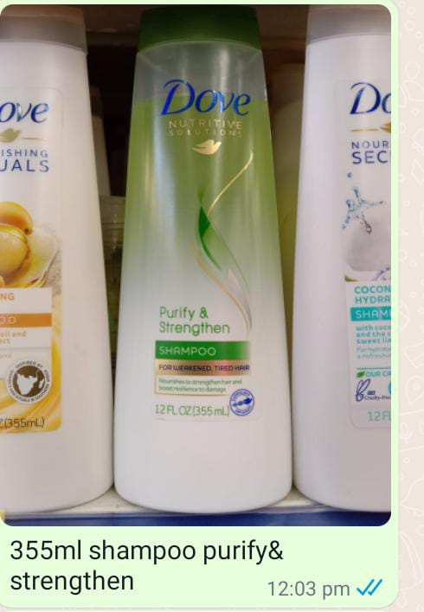
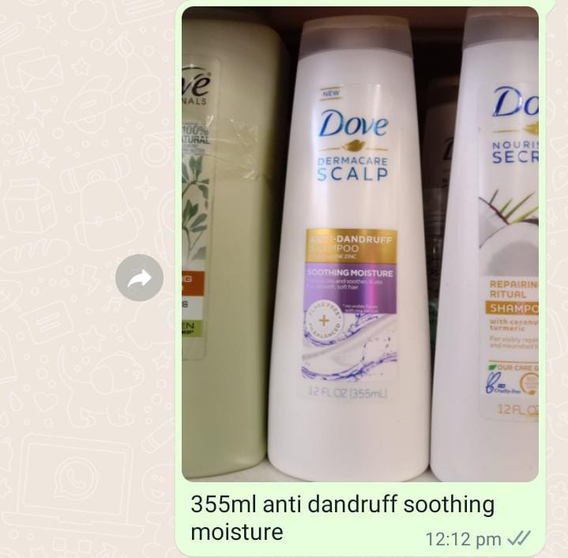
Channal Metro
Dove Shampoo Reparing
Ritual 355ml
Dove Shampoo Purify &
Strengthen 355ml
Dove Shampoo Smoothing
Moisture 355ml

Slide 15
NAME SURNAME | +27 000 0000 | name.surname@smollan.com

